Slide 1
More Constitutional Hypotheticals
The U.S. Constitution

Slide 2
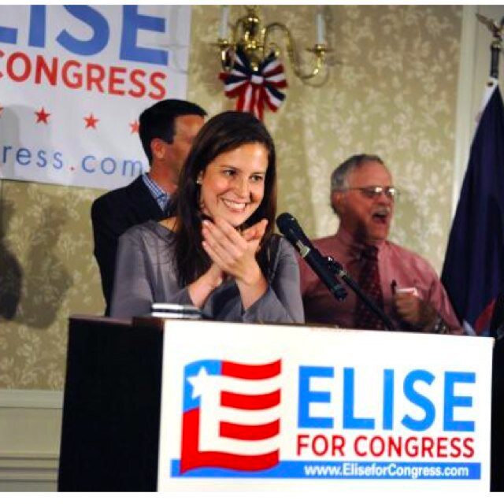
Elise Stefanik
30 Years Old
House of Representatives
New York’s 21st District
On Tuesday November 4, 2014 Elise Stefanik was elected to the U.S. Congress. She now holds the record for being the youngest member. Can someone break her record in the future?

Slide 3
Constitutionality of Executive Orders
View the video at either of these two locations, pausing at 2:04.
http://www.flackcheck.org/video-wire/president-obamas-executive-overreach/
or https://www.youtube.com/watch?v=ybG0BX7v6OQ
Then determine who has the power to declare an executive order unconstitutional.
Once you have arrived at your answer, watch the rest of the video to see if you were correct.

Slide 4
Budget Issues
View the video at https://www.youtube.com/watch?v=WRDpULWOS80, pausing at :27 seconds.
Is this correct? Did the Congress act against the U.S. Constitutional law Palin refers to?
After answering, watch the rest of the video to check answers.

Slide 5
Vacation Time?
Congress is on “vacation.”
Can the President or members of Congress truly be on vacation? (hint: think about emergencies)

